Slide 1


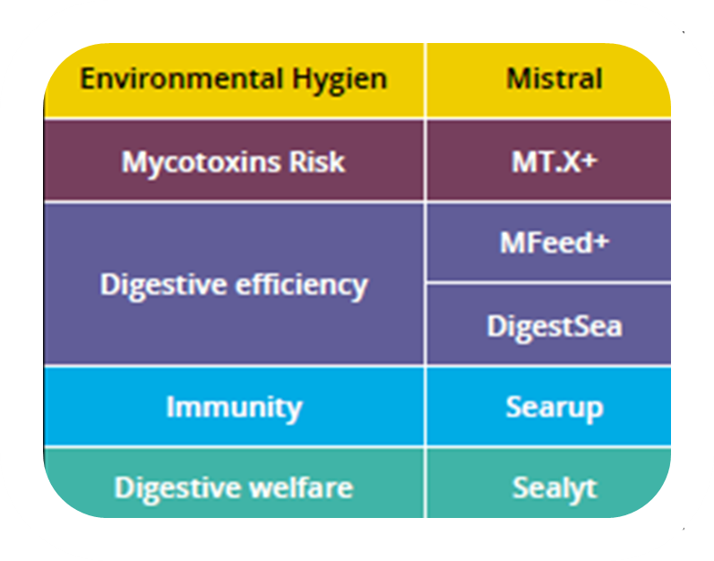
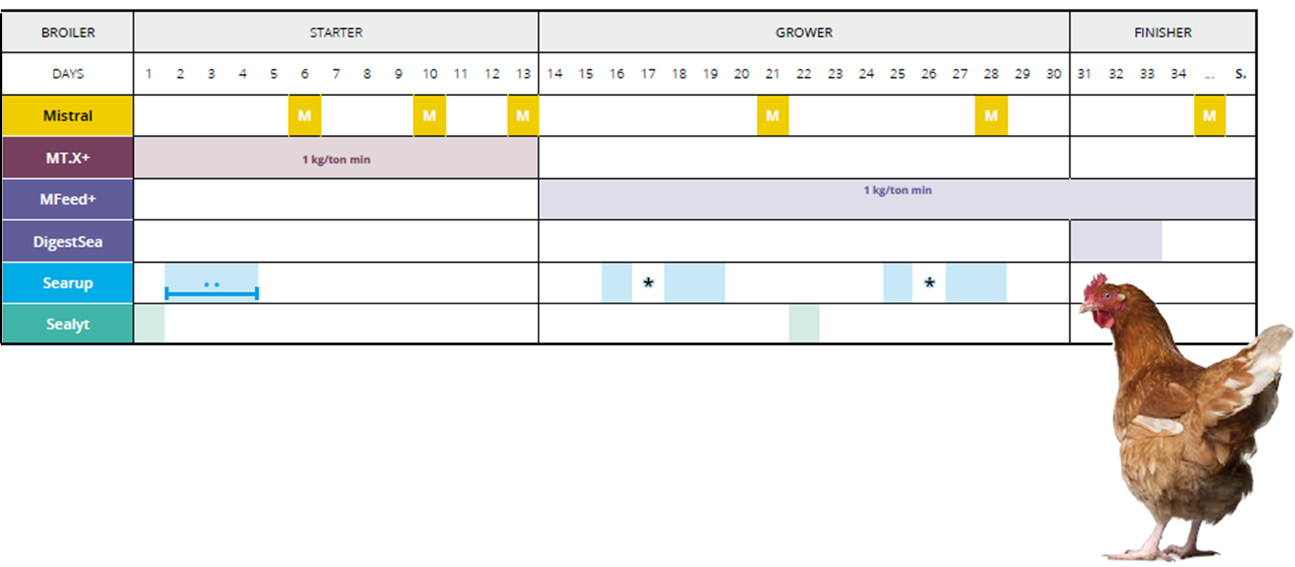
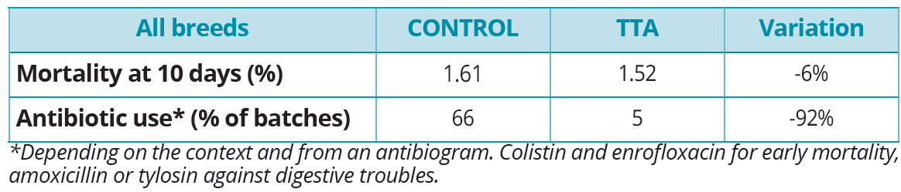
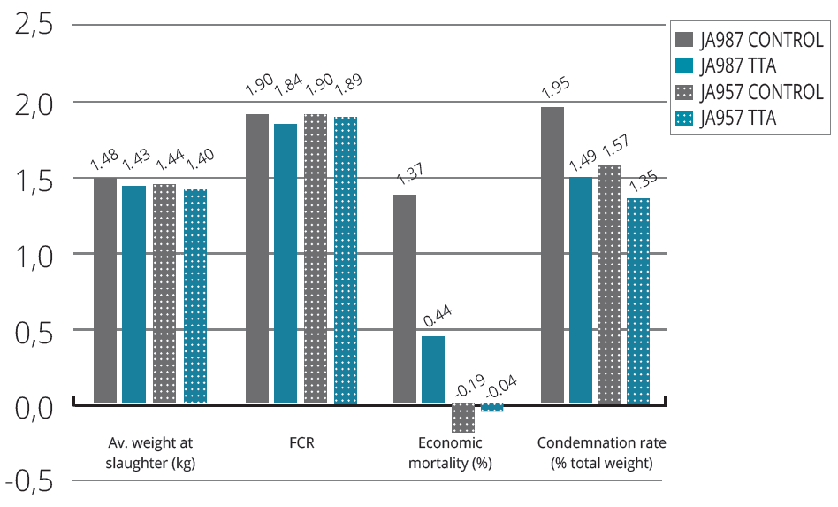
Can Seaweed replace Antibiotics in the farming industry?
A case study on raising broilers
Dr. Phát LUONG TAN, Olivier BIANNIC, Pi NYVALL-COLLEN
OLMIX SA – ZA du haut du bois, 56580 Bréhan, France, animalcare.ts@olmix.com
INTRODUCTION
Animal protein consumption is rising globally at an unprecedented rate. Animal production practices are associated with regular use of antimicrobials for disease prevention and growth promotion. 63 000 tons of antibiotics are currently introduced in animal food per year and this figure is inclined to increase by 67% in 2030, reaching over 105 000 tons/yr [1]. This widespread use of antimicrobials in livestock contributes to potential selection pressure on bacteria and hence the emergence of resistant strains in animals and in humans [2]. The development of antibiotic resistance is one of the top five public health concerns according to the WHO.
A major challenge in the animal farming industry will be to reduce the use of pharmaceuticals while maintaining growth performances in order to support the growing demand for meat. Interest for exploring natural bioactive products, able to improve animal health or act against infections, has increased. Seaweed in particular, expose an abundant and divers range of metabolites suggested as prime material for the pharmaceutical industry [3]. This poster will present a case study of using a range of seaweed based food additives in an industrial poultry farm with the aim to reduce the use of antibiotics.
EXPERIMENTAL PROTOCOL
Four different food additives (SeaLyt, Searup, Mfeed+ and MT.X+) based on seaweed extracts from the green seaweed Ulva sp. as well as one sanitizer powder (Mistral) were used throughout the duration of the trial. All products are found on the market and commercialised by Olmix Group, and demonstrate specific health applications as shown in Table 1. The trial was based on applying a feeding program described in Table 2, which combined the use of these products at recognised stressful periods of the life of broilers (reduced immune system…etc).
Two broiler genetics were tested: JA 957 and JA 987. 411 459 broilers (50% JA 957/JA 987) divided in 11 batches received the feeding program based on seaweed extracts (named TTA). A control population counted 634 453 broilers divided in 14 batches (52% JA 957, 48% JA 987) and received conventional feed.
Population density was high : 28-32 birds/m²
The trial lasted 32 days (April - June 2015) and took place in a conventional farm located in France
Table 1
Product applications
Table 2
Feeding program applied during the experiment
Experimental data was collected during the trial : number of antibiotic administrations per batch, number of mortalities.
Zootechnical performances were measured at the end of the trial : average weight at slaughter, Food Conversion Ratio (FCR), economic mortality and condemnation rate.
RESULTATS
Reduced antibiotic use
The number of batches, all genetics mixed, which received antibiotics reduced from 66% in the control trials to 5% in the TTA trials (see Table 3).
Mortality counts at 10 days were low in both control and TTA trails and only decreased slightly, 1.6 to 1.5 % respectively.
Identical Zootechnical performances
The average weight at slaughter maintained a stable value, between 1.40 and 1.48 kg per broiler, independently of the control or TTA trails and of the genetics.
The FCR calculated at the end of the trials, showed no significant change between control and TTA trails or between genetics, with values between 1,84 and 1,9 kg animal weight/ingested food weight.
Reduced animal meat loss
Economic mortality reduced significantly for JA 987 populations, from 1,37% in the control trails to 0,44% in the TTA trails. Economic mortality was already low and remained unchanged for JA 957 populations.
Condemnation rate reduced by 25% for JA 987 populations and by 14% for JA 957 populations between control and TTA trials.
Table 3
Mortality counts and number of antibiotic applications for both genetics during the trial
Table 4
Zootechnical performances measured after the trial
CONCLUSION
Independently on the genetics, the attribution of seaweed based additives to broilers, according to a specific feeding protocol, reduced antibiotic treatments by 92% without significantly affecting zootechnical performances. Moreover, le overall meat loss (economic mortality) for JA 987 populations was reduced by 68% when applying these seaweed based additives.
In a global context where the demand for meat is increasing, seaweed based additives seem to offer an alternative to reduce antibiotic treatments in the farming industry and simultaneously improve animal health and reduce economic loss for the farmers.
Further trails are in progress regarding swine and turkey populations in order to adapt this protocol to other sectors in the farming industry.
REFERENCES: [1] Van Boeckler T.P. et al. (2015). Global trends in antimicrobial use in food animals. PNAS 112(18) : 5649-5654, [2] Vieira AR, et al. (2011) Association between antimicrobial resistance in Escherichia coli isolates from food animals and blood stream isolates from humans in Europe: An ecological study. Foodborne Pathog Dis 8(12):1295 – 130, [3] Smit J. (2004). Medicinal and pharmaceutical uses of seaweed natural products: A review. Journ. Appl. Phycology 16: 245 – 262.
11 Asian Pacific Poultry Conference 25-27 June 2018, Bangkok Thaïland
www.olmix.com

